Slide 1
HOW TO APPLY FOR A
PUBLIC ACCOUNT
SAUSALITO eTRAKiT

Slide 2
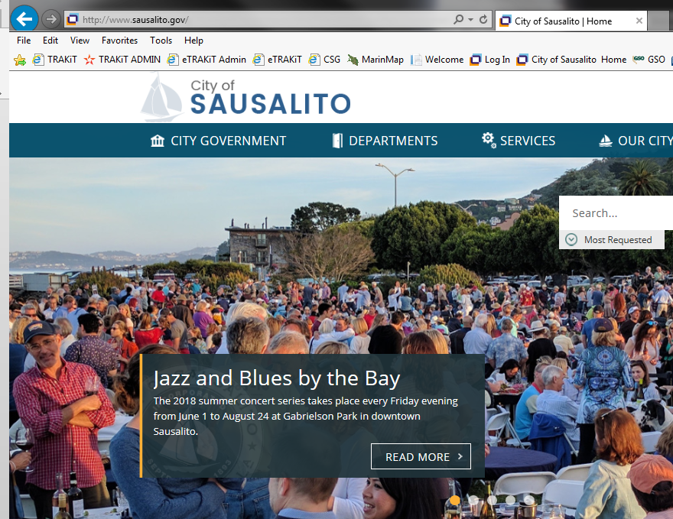
1. Go to the City of Sausalito’s website at www.sausalito.gov

Slide 3
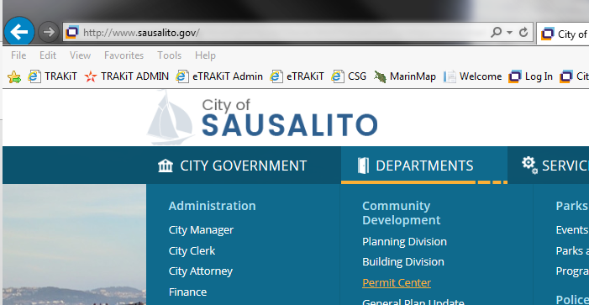
2. Under “Departments”, in the Community Development section, click on “Permit Center”.
PLACE MOUSE OVER TO OPEN SCROLL LIST
CLICK HERE

Slide 4
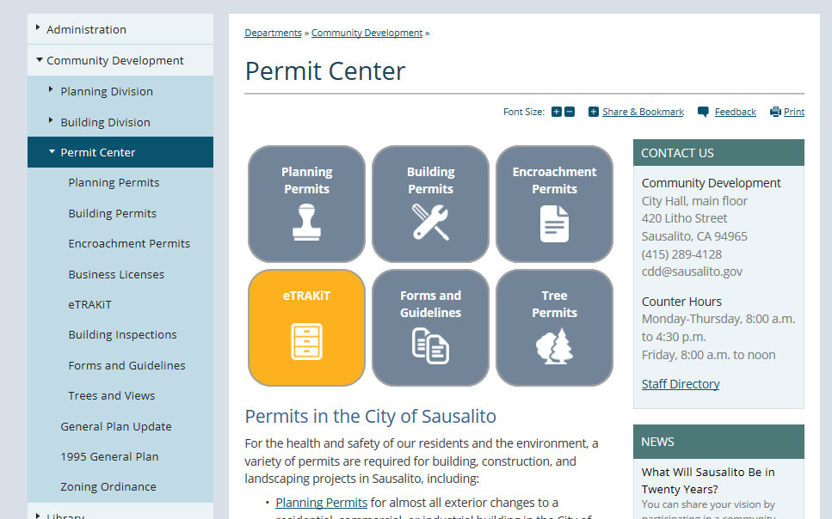
3. Under “Permit Center”, click on the “eTRAKiT” icon box.

Slide 5
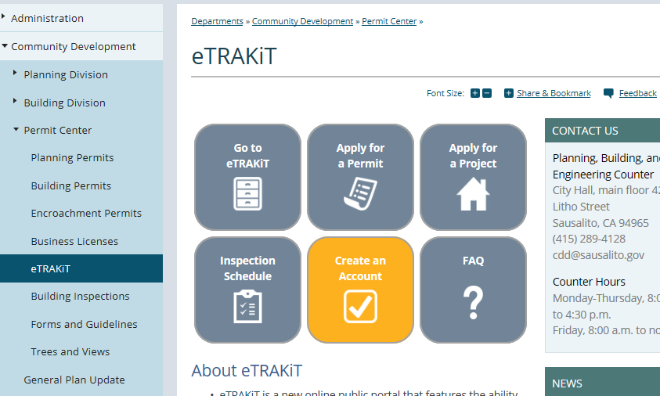
4. Through the eTRAKiT information page, click the “Create an Account” icon box.

Slide 6
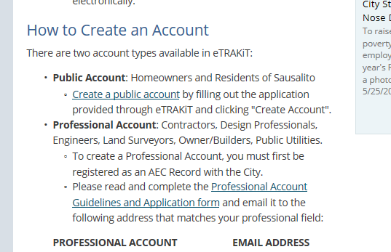
5. The first bullet point will list information about the “Public Account” and how to register. Click on the “Create a public account” link to be redirected to eTRAKiT to apply.
CLICK ON LINK TO BE REDIRECTED TO eTRAKiT

Slide 7
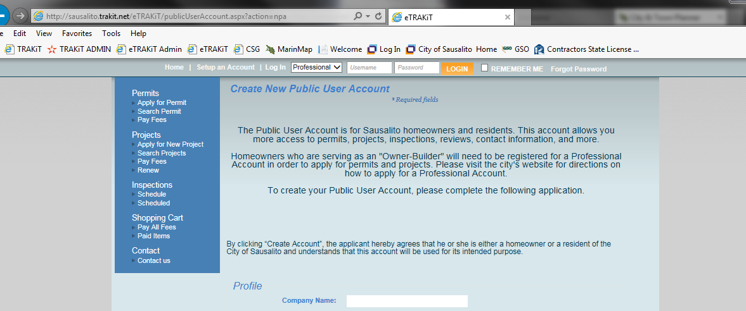
6. The link will take you directly to the application page on eTRAKiT. Please read the information before beginning to fill out the application.
PLEASE READ ALL INFORMATION TO MAKE SURE YOU’RE APPLYING FOR THE RIGHT PERMIT

Slide 8
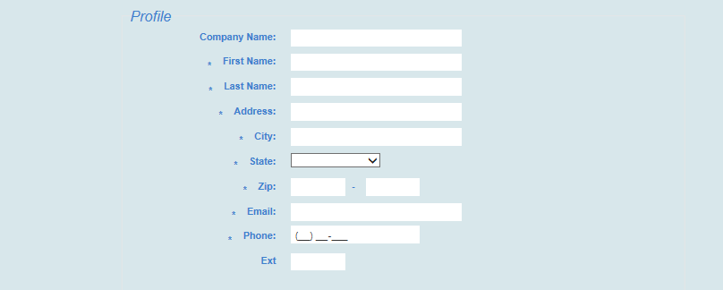
7. The beginning of the application is basic information. Please complete all fields that have an asterisk (*) next to it.
THESE FIELDS WILL BE MANDATORY TO COMPLETE BEFORE CONTINUING

Slide 9
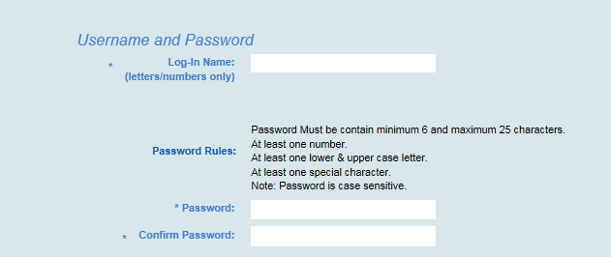
9. The second part of the application will involve creating your username and password. Please follow the guidelines when creating both.
FOLLOW THE DIRECTIONS IN ORDER TO MAKE SURE YOUR USERNAME AND PASSWORD ARE ACCEPTED

Slide 10
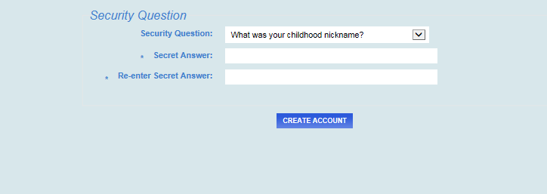
9. The last part of the application is the security question. Please select the question of your choice. The answer to your question will be case and space sensitive.
CLICK THE ARROW TO OPEN UP THE SCROLL LIST TO SELECT DIFFERENT QUESTIONS

Slide 11
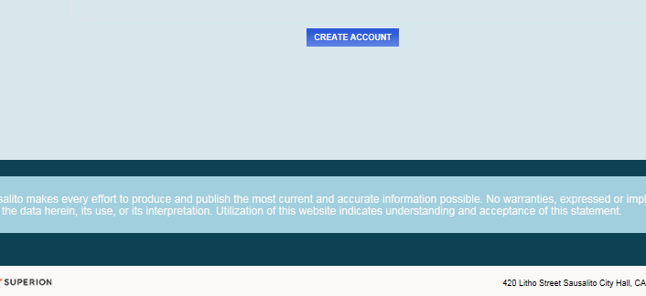
10. When the application is completed, click on the “Create Account” button at the bottom of the screen.

Slide 12
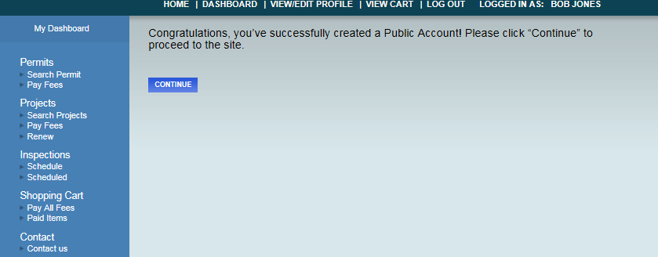
11. If all information was accepted, the page will be redirected to a confirmation page. Click “Continue” to proceed to your new account.

Slide 13
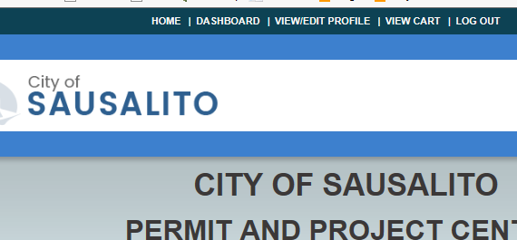
12. After clicking “Continue”, the page will redirect to the eTRAKiT homepage. At the very top, the directory bar will list a view different options:
THIS WILL BE YOUR NAVIGATION BAR TO ALLOW YOU TO GET TO DIFFERENT PAGES IN eTRAKiT

Slide 14
13. When you are done using eTRAKiT, you may log out by clicking “Logout” at the top of the screen.

Slide 15
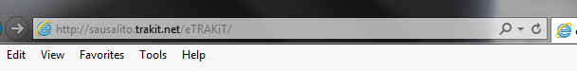
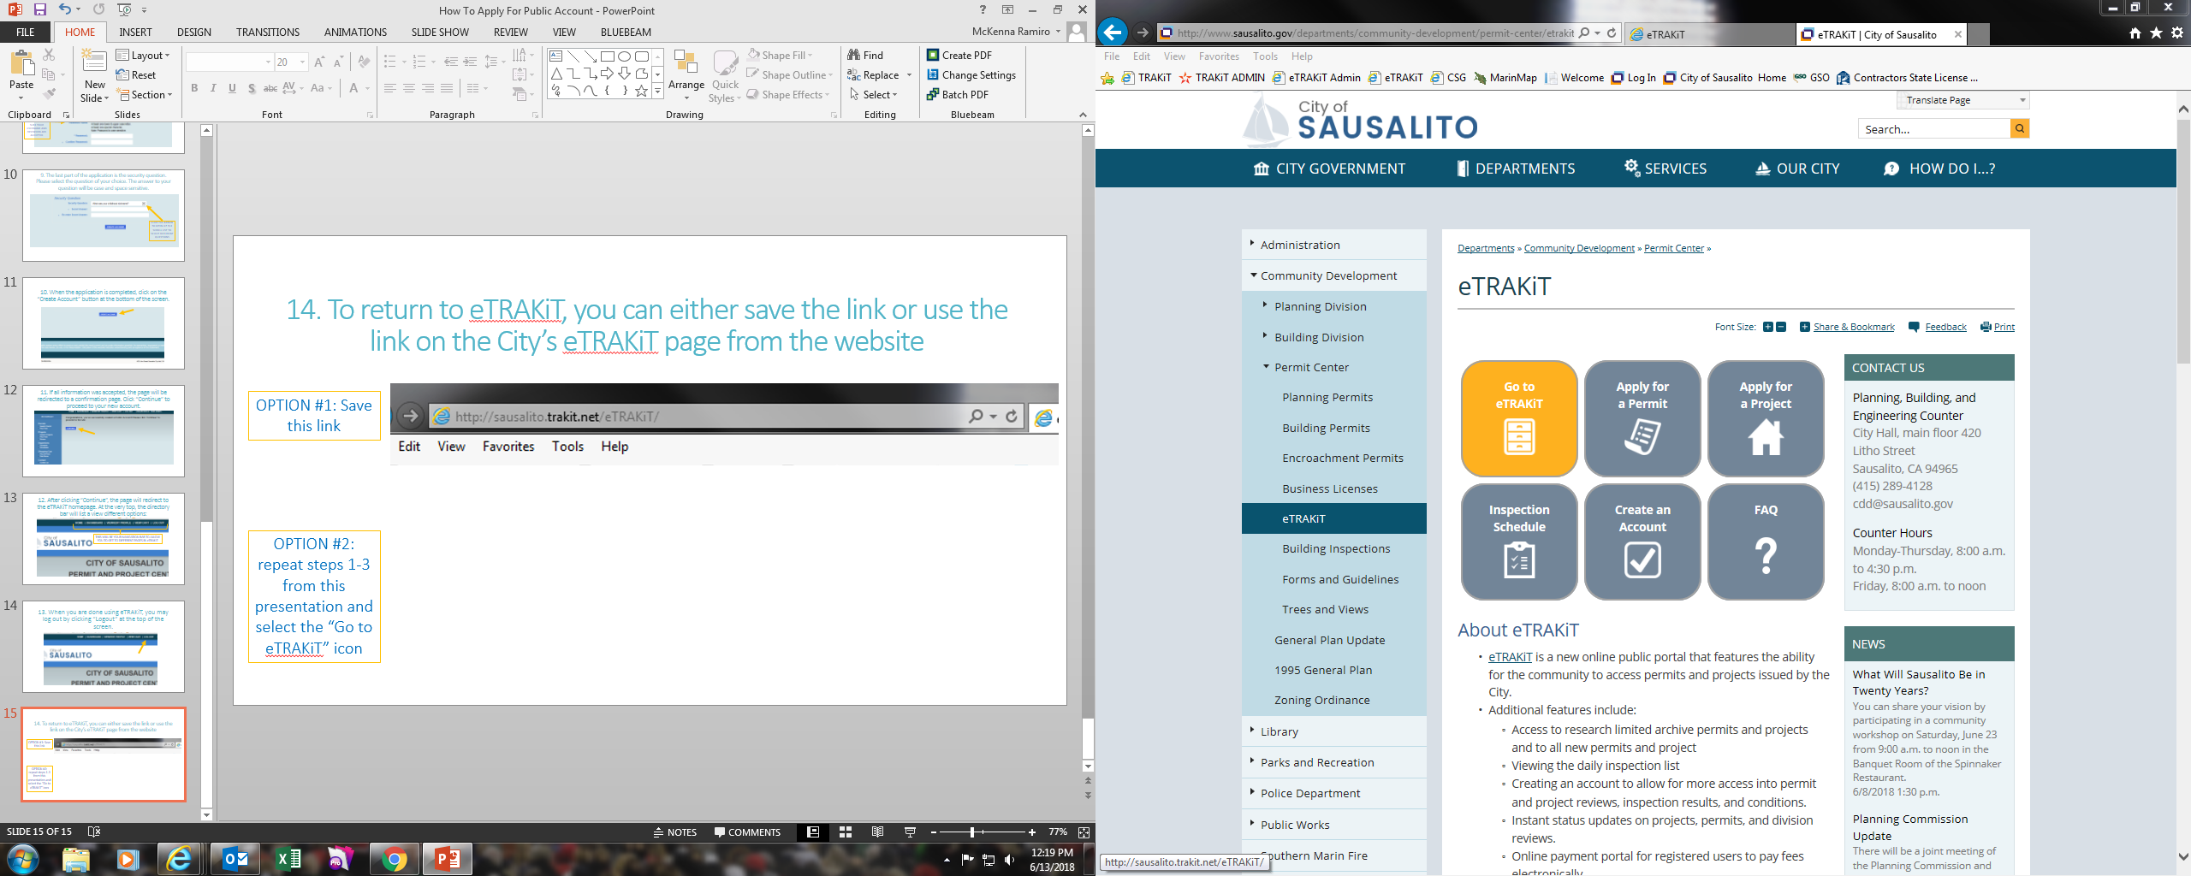
14. To return to eTRAKiT, you can either save the link or use the link on the City’s eTRAKiT page from the website
OPTION #1: Save this link
OPTION #2: repeat steps 1-3 from this presentation and select the “Go to eTRAKiT” icon

Slide 16
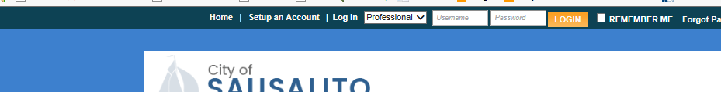
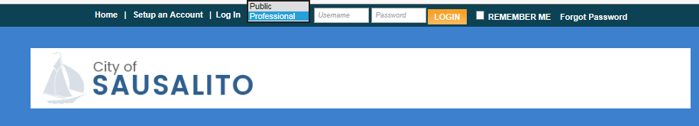
15. Once returned to eTRAKiT, log in by switching the top scroll bar to “Public”
Click the arrow to drop the options down
Then, select “Public” to allow you to sign in

Slide 17
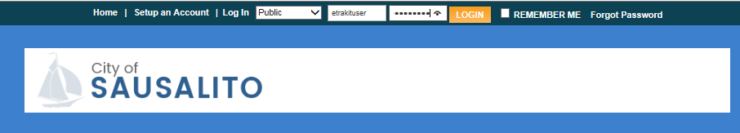
16. After switching to “Public” login, fill out the text boxes with your username and password and click “Login”

Slide 18
17. If you forget your password, click the “Forget Password” text next to the login

Slide 19
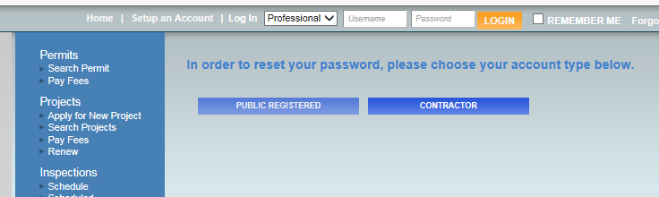
19. Click the “Public Registered link

Slide 20

19. Enter the username you created in the text box and click “Reset password”

Slide 21
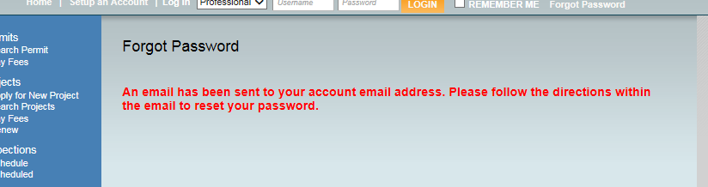
20. You’ll get a notice that an email has been sent to your email attached to the Public Account. Please log into your email for the next step.

Slide 22
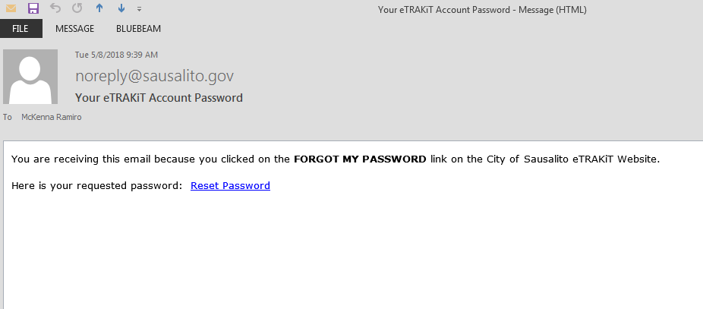
21. The email, sent by noreply@Sausalito.gov, will contain a link to reset your password.
Click the link to be redirected to changing your password

